Slide 1

Project SocioScope
Aspect-Based Sentiment Analysis for Socio-Economic Tweets
Students: Ofir Fichman, Pavel Fadeev, Israel Peled

Slide 2

Motivating Use Case: The Pulse of Public Opinion
Why It Matters?
Understanding real-time public reactions to socio-economic policies helps guide better decisions and prevent unrest, offering faster, large-scale insights than traditional surveys.

Slide 3

Defining the Project Task
Formal Problem Statement
Inputs and Outputs
The task is to detect socio-economic aspects mentioned (e.g. healthcare, education) in tweets and classify the sentiment expressed toward each aspect.
Input: Raw tweet text.
Output: A vector where each index represents a specific socio-economic aspect, and its value indicates the corresponding sentiment score.

Slide 4

Models and Methods: Our Analytical Pipeline
Data Collection & Genration
Aspect Extraction
Model Evaluation
Preprocessing
Sentiment Classification

Slide 5

Data Specification and Generation
We will use both scraped real tweets and LLM-generated synthetic tweets.No manual labeling is performed—aspect and sentiment annotations for the synthetic data are produced automatically by an LLM.Combining real and synthetic tweets provides a more diverse and robust dataset for model training and testing.

Slide 6
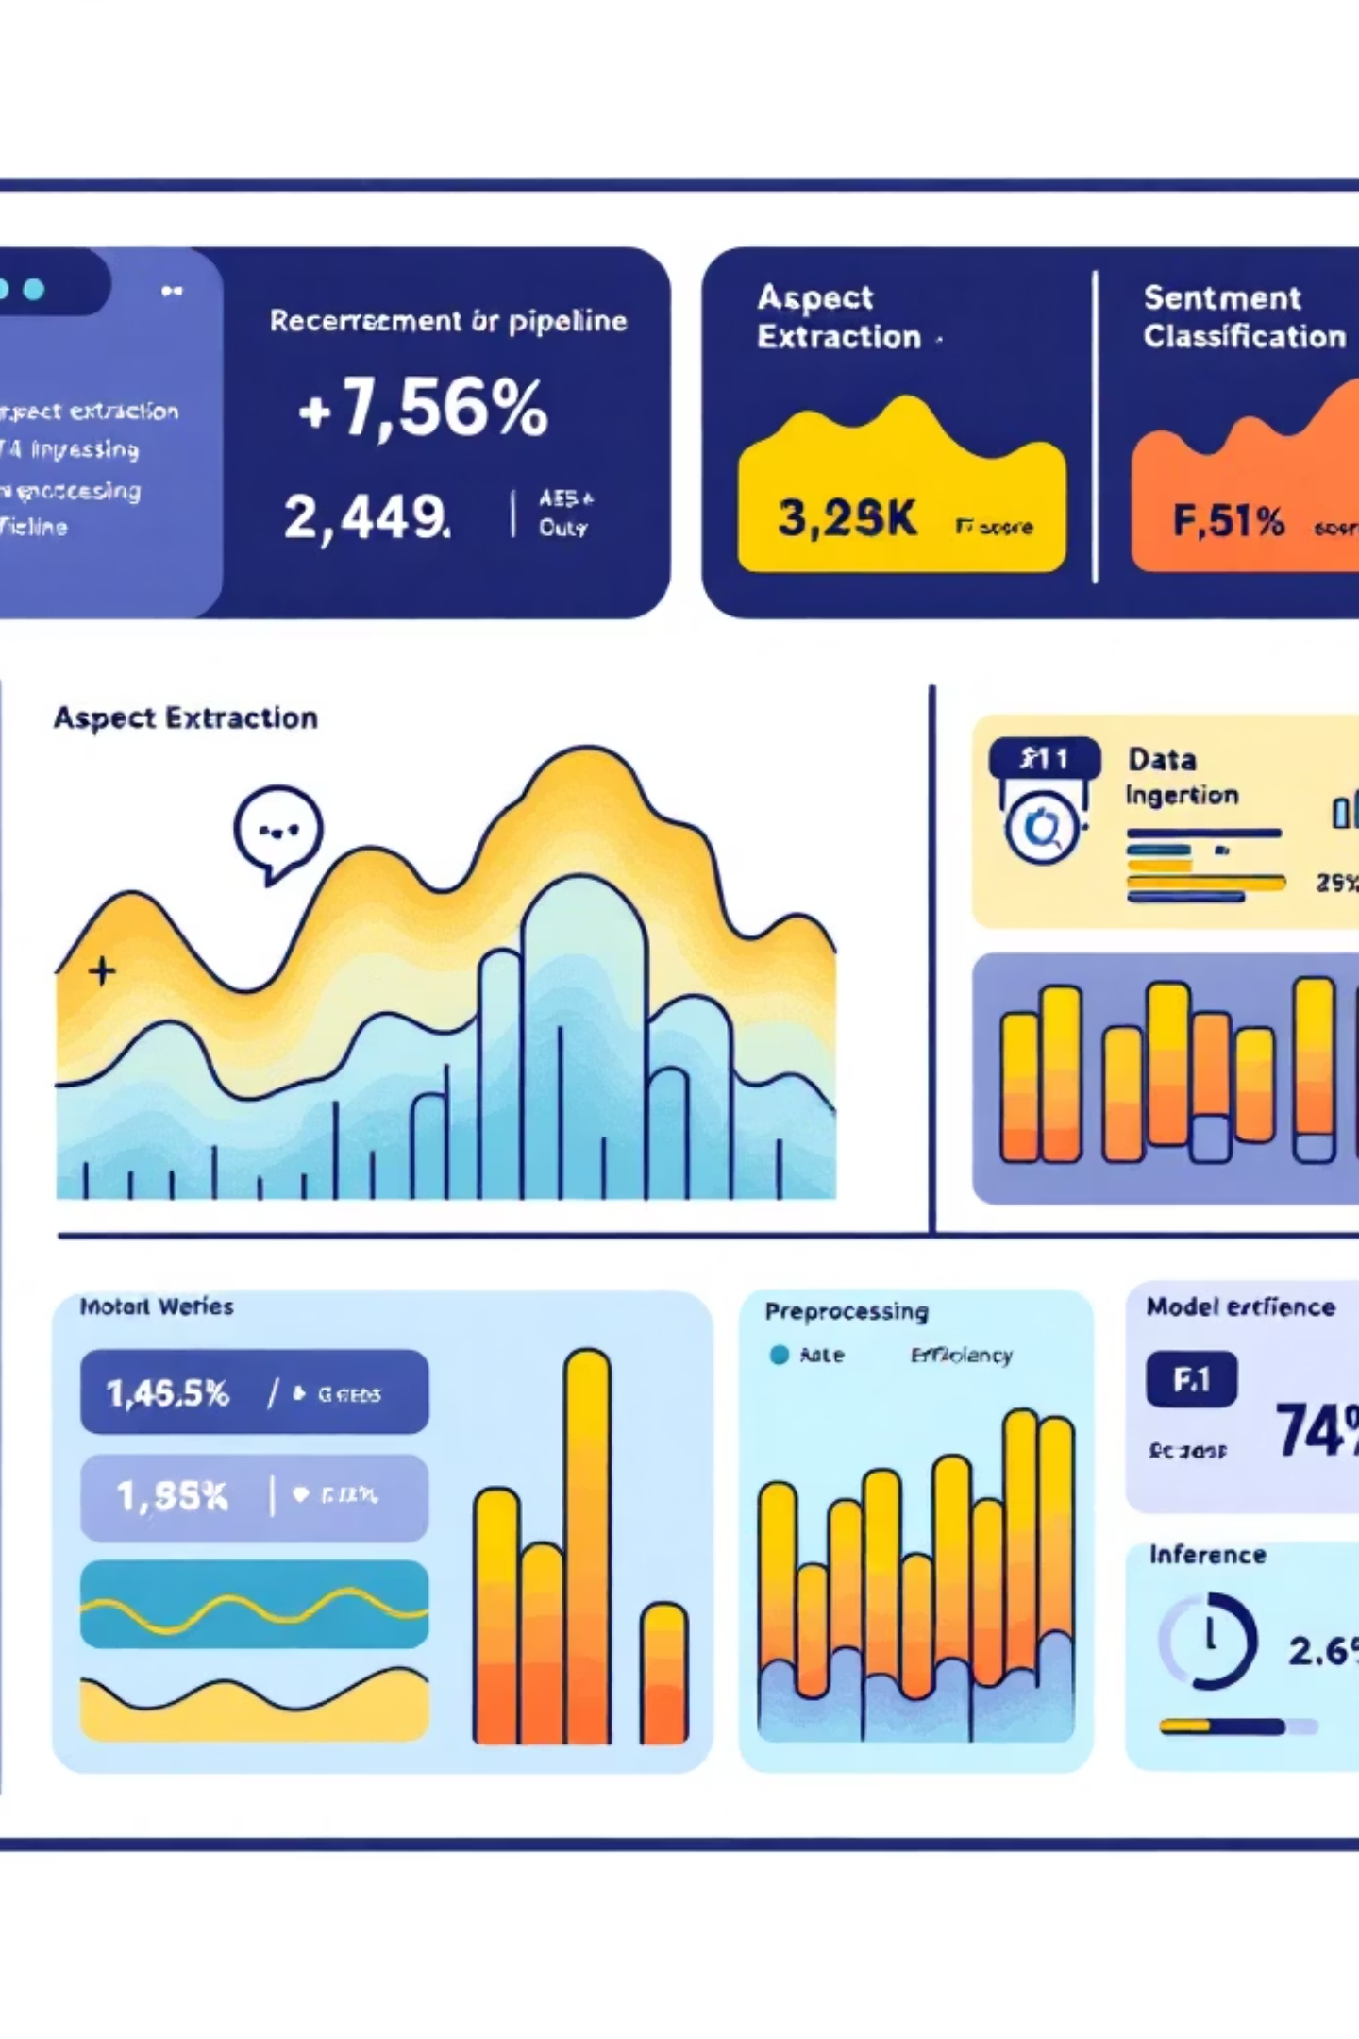
Metrics and KPI
Key metrics such as Precision, Recall, and F1-score will be used to evaluate how well the system identifies the correct socio-economic aspects and assigns the appropriate sentiment. These metrics provide a clear measurement of accuracy, and the overall reliability of the model’s predictions.

